Slide 1
Categorise the following data collection tools:
Do Now
 | Interviews | Likert scale | Heart rate
Subjective OR Objective
Qualitative OR Quantitative
Reminders:
Phones away
Bags on floor
Books out
Pens out
Whiteboard

Slide 2
Write 2 likert scale questions that could help measure a persons extroversion
Do Now
Reminders:
Phones away
Bags on floor
Books out
Pens out
Whiteboard

Slide 3
Chloe is a personal trainer at Gold’s Gym. Although she has always officially led a “straight edge” lifestyle and denounced the use of anabolic steroids, she’s always secretly wondered if they helped people get significantly stronger. She decides to find out. She purchases some steroids off the black market from her dealer Jiggy and convinces half of her clientele at the gym to start injecting. This continues for thirty days while Chloe keeps a journal of how much weight each person in the two groups can squat. At the end of the month she compares the results.
Do Now
Identify the:
1. IV and DV
2. Experimental group and Control group
Write an operationalized hypothesis for this scenario
Reminders:
Phones away
Bags on floor
Books out
Pens out
Whiteboard

Slide 4
Shortly after adopting his cat, Sassy, Thomas realized that his poor kitty isn’t eating very much. After ruling out and confounding variables, he determined that Sassy is a huge diva and is simply very picky about the type of food she eats. He decides to run a month-long experiment, separated into four weeks. In the first week, he feed her normal dry food. In the second week, he feeds her wet canned food. In the third week he feeds her feeds her raw salmon. In the final week he feed she home-cooked liver and gravy. At the end of the experiment, Thomas compares how much of each type of food Sassy ate.
Do Now
Identify the IV and DV
Identify the three different experimental conditions
Identify the control condition
Reminders:
Phones away
Bags on floor
Books out
Pens out
Whiteboard

Slide 5
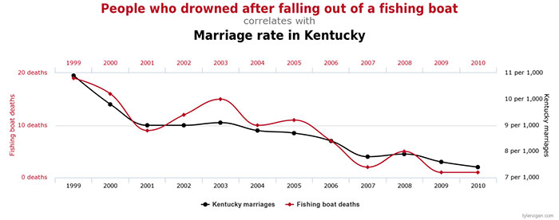
1. How many fishing boat deaths were there in 2004? 2. Describe the correlation between the years 1999 to 2001.
Do Now
Reminders:
Phones away
Bags on floor
Books out
Pens out
Whiteboard

Slide 6

Learning Intentions
I will be able to describe the different functions of descriptive and inferential statistics
I will be able to interpret a p value and know their purpose

Slide 7


Descriptive v Inferential Statistics
Descriptive statistics – organise and summarise a set of data.
e.g. measures of central tendencies and measures of dispersions
Inferential statistics – allow us to draw conclusions from the results and generalise these findings to the larger population
Determine the probability that the measured difference between two groups are due to chance and allow researchers to state with a level of confidence that their results are due to the IV affecting the DV.

Slide 8
P values explained
When are they used? Experimental research to show cause & effect
The purpose of P value is to test the hypothesis and to state whether the results are
- due to chance (or extraneous variables) or
- due to the manipulation of the IV.
The p-value is a range from 0 to 1 with a p-value of less than .05 being statistically significant. This means that the results have a less than 5% percent possibility of being due to chance and not the experimental conditions.

Slide 9
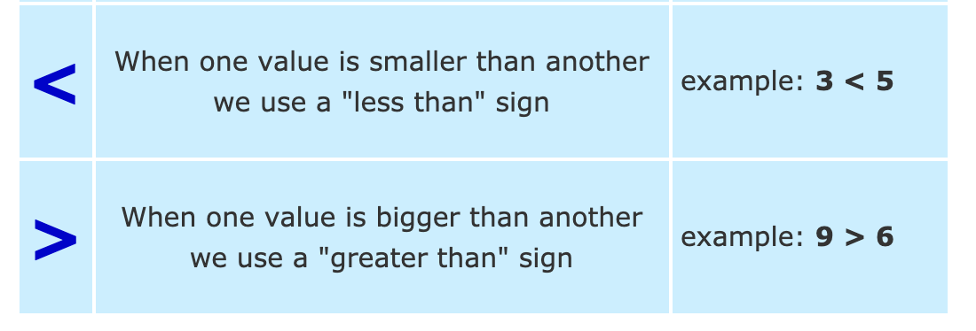
Reading and Describing P values
P > .05 reads as “the probability is greater than 5%”
P < .03 reads as “the probability is less than 3%”
Researchers want a small P value so that they can state with some confidence that their results are due to the IV impacting the DV and not chance / extraneous variables
Practice what do these read as:
7 > 6
8 < 9
4 < 2
6 > 3
P < .3
P > .05
P > .04
P < .01

Slide 10
P > 0.05 This reads as: the probability is greater than 5%
P < 0.05
This reads as: the probability is less than 5%
The conclusions you can draw:
The results are statistically insignificant
The operational hypothesis is rejected
as there is over a 5% probability that results are due to chance
The difference between the experimental and control group is not due to the IV being manipulated.
The conclusions you can draw:
The results are statistically significant
The operational hypothesis is supported.
The difference between the experimental and control groups is due to the Independent variable being manipulated and not due to chance.

Slide 11
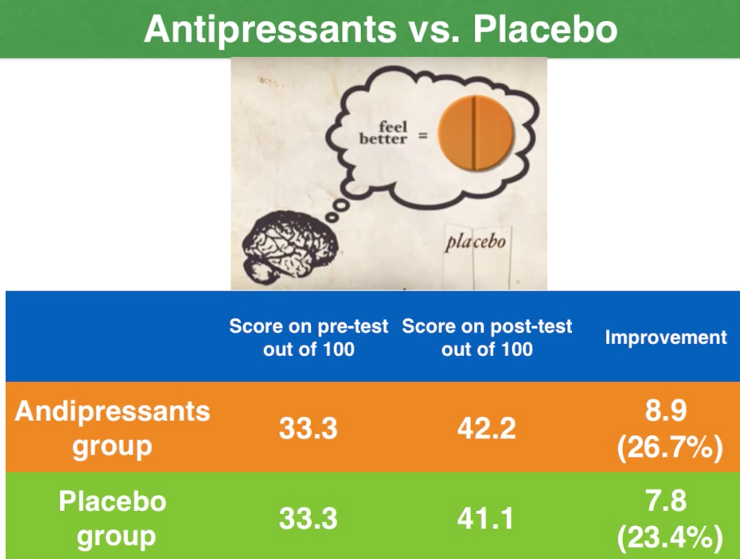
1. Which group shows the most difference from pre to post test??
Example
2. Are the results statistically significant if
p >0.05??

Slide 12
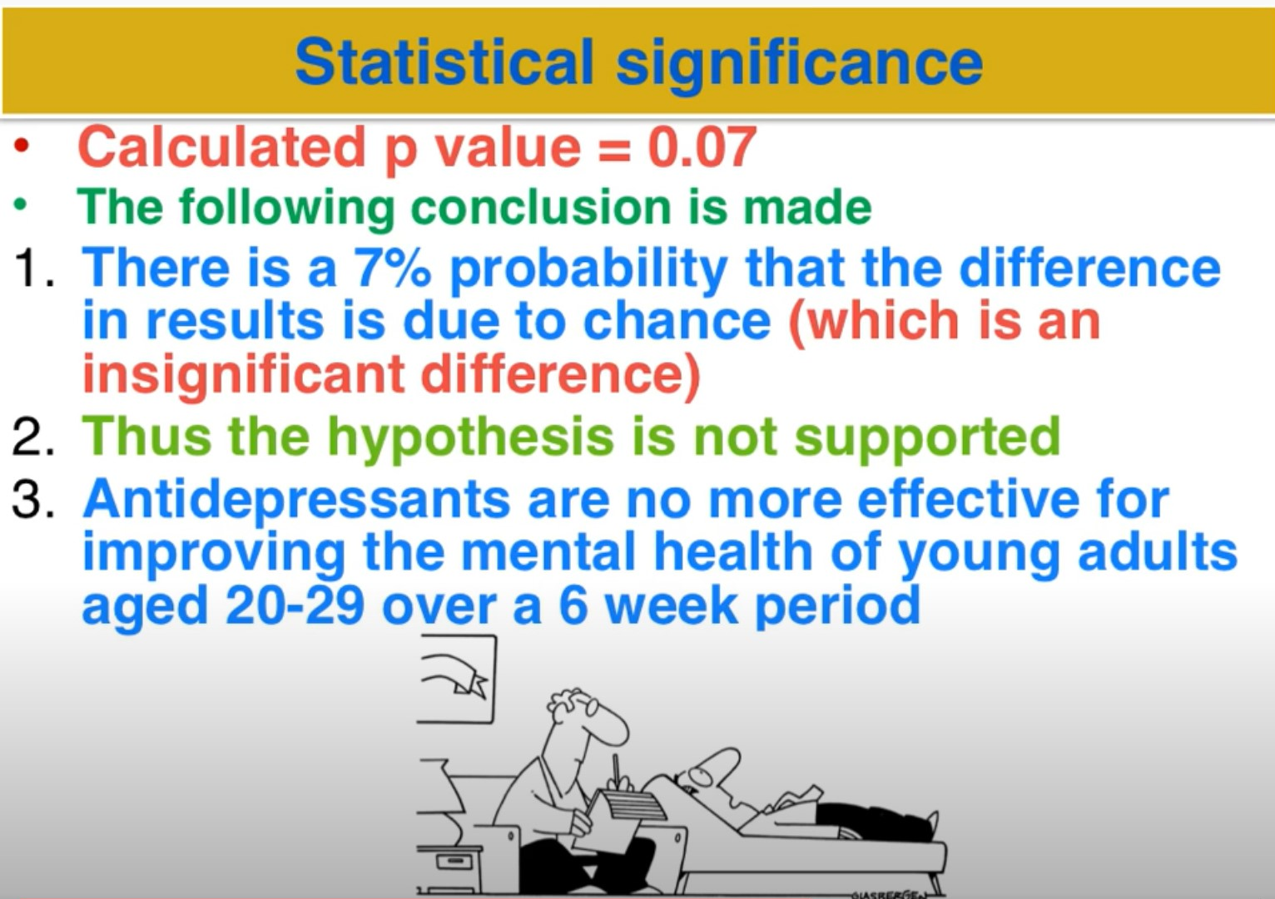
Worked example of the conclusions you can draw for insignificant results or a P greater than .07 (p > .07)
Example

Slide 13
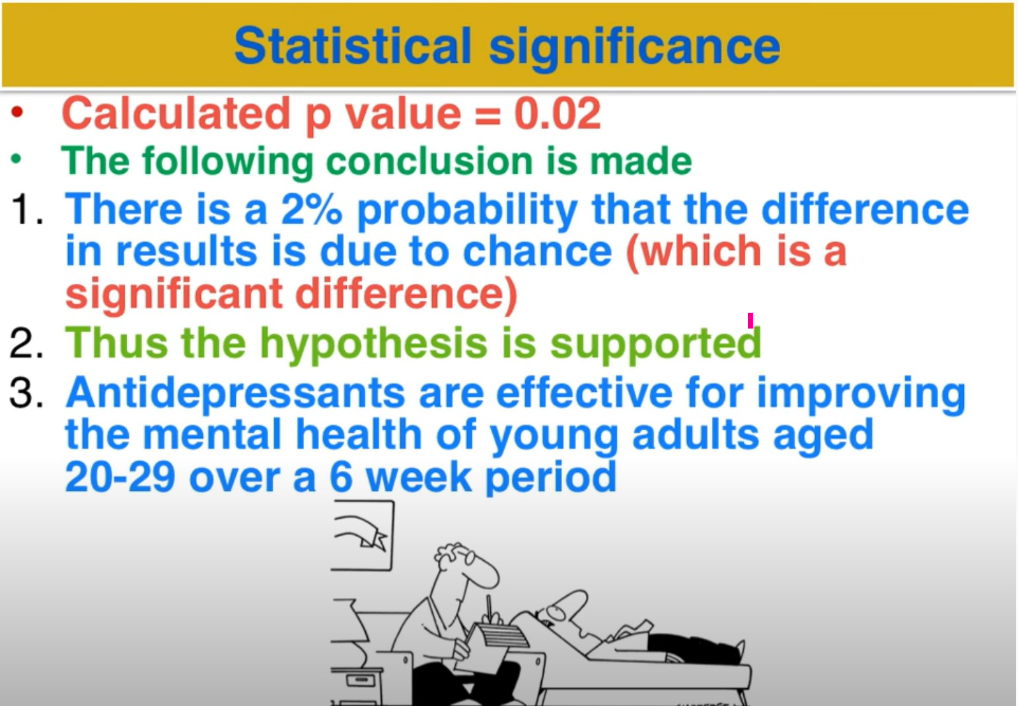
Worked example of the conclusions you can draw for significant results or a P less than .05 (p > .02)
Example

Slide 14
Let's act!
1. What is a theory
Why do we test theories
What is a measure of central tendency (use examples)
What is a P value
What is a measure of dispersion
What is an extraneous variable
What does the term reliable mean
Instructions:
Partner up
Person 1: A year 7
Person 2: A teacher
After each question switch roles.
You are acting the part and trying to explain the answer to a year 7 so simple language, relate it to them and use examples.
This is a form of active rehearsal to strengthen the neural networks.
Reminder – year 7s ask a lot of questions!

Slide 15
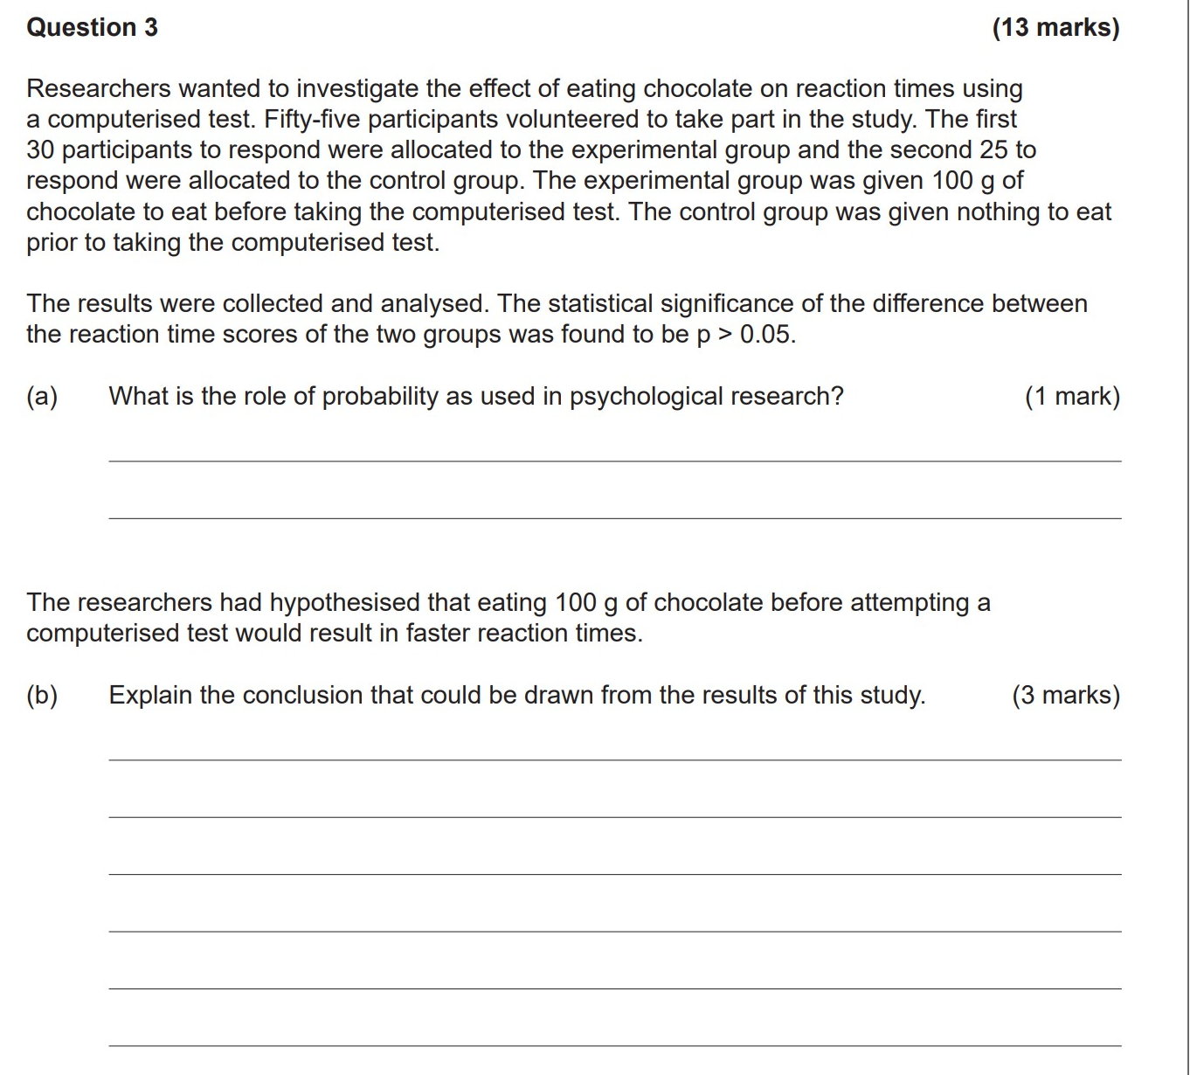
PRACTICE

Slide 16
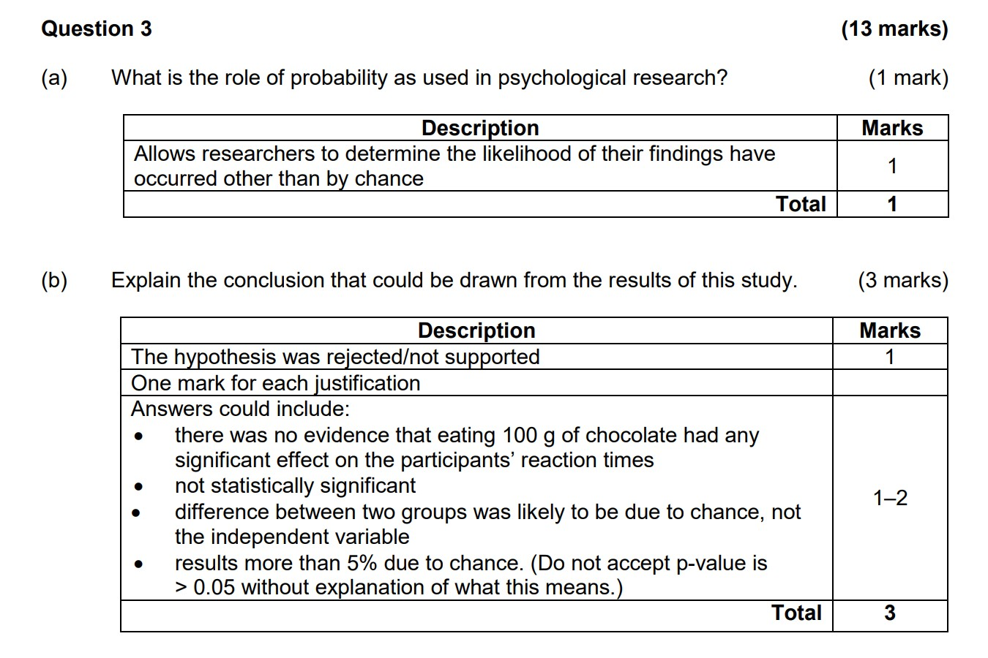
Answers

Slide 17
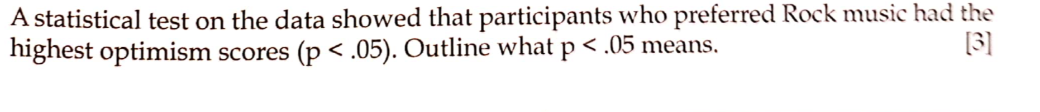

Slide 18
answer
The result is statistically significant as more than 95% of the results are due to the change in the independent variable
There is only 5% chance that the results are due to chance
This is a real difference caused by the independent variable

Slide 19
Data interpretation questions on SEQTA
- Answer and self-mark

